Slide 1
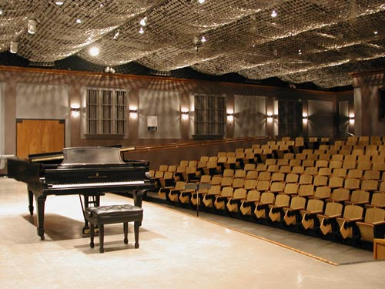
Singing Techniques
Kaela Raku
Danielle Yandow
Johanna Schillemat

Slide 2
Introduction
Singing Techniques
Spring 2009
Help students better their performance skills

Slide 3
Why is this class important???

Slide 4
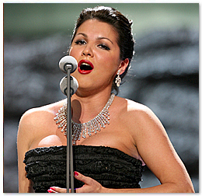
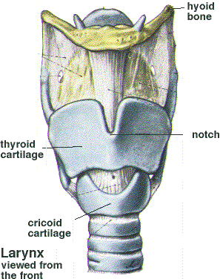
Syllabus
Standards
Objectives
Projects

Slide 6
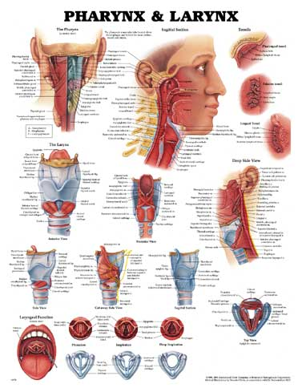
Budget
Textbook
Vocal Model Posters

Slide 7
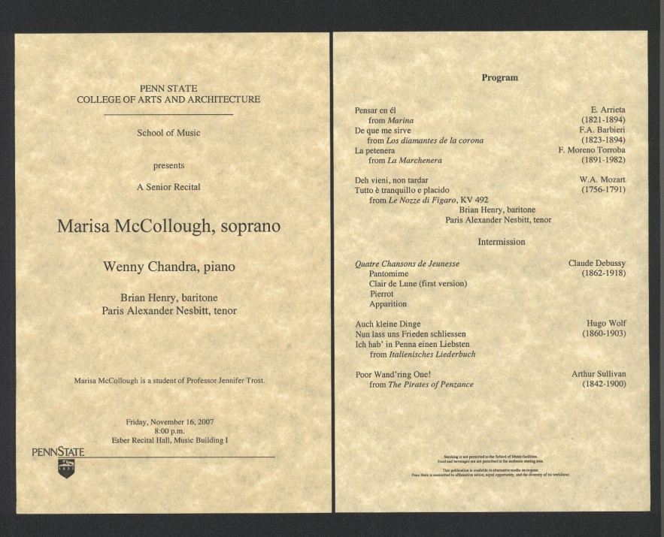
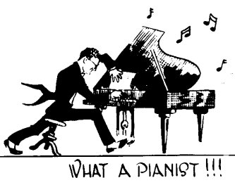
Budget
Professional Performance
Accompanist

Slide 8
References
Samantha Fand, Music Education Student, PSU
Silver Center for the Arts Box Office
Holly Oliver’s syllabus, lesson plan design handout, lesson plan template, and rubric
www.amazon.com
www.ebay.com
www.american3BScientific.com
www.evolutionary.com
www.biblio.com
www.alibris.com
www.busrates.com
Large Format Poster
Ps Printing
Ink Chaser

